Slide 1
Muscular System

Slide 2
Types of Muscles:
Skeletal Muscle Tissue
Cardiac Muscle Tissue
Smooth Muscle Tissue

Slide 3
Skeletal Muscle Tissue
AKA Striated Muscles: These are voluntary muscles. Consciously controlled.
They are composed of distinctive light and dark bands
These muscles also have a limited capacity for regeneration due to the small number of cells that can divide.

Slide 4
Cardiac Muscle Tissue
Found only in the heart.
It is striated like skeletal muscle, however not as heavily.
It is not under conscious control. (Involuntary).
This type can regenerate under certain conditions,
Such as heart tissue transplants

Slide 5
Smooth Muscle Tissue
Non-striated tissue and is found in the blood vessels, stomach, intestines, and airways.
This tissue is involuntary and has the greatest ability of any of the muscle tissue to regenerate. But it is still far more limited than other tissues.

Slide 6
Functions of the Muscular System
1. Movement: Walking running and jogging are the movements that are voluntary and produced by the skeletal muscles along with the work of the nervous and skeletal system.

Slide 7
2. Stabilizing Body Positions: Skeletal Muscles are constantly contracting to keep your body posture upright. When any of these muscles are not used or become injured an problem in the skeleton may arise.

Slide 8
3. Regulating Organ Volume: Contractions of ring like sphincter muscles prevent overflow of organs such as the bladder or stomach.
4. Moving Substances within the Body: Smooth muscles and cardiac Muscle do most of this work.
Cardiac Muscle pumps the blood though the blood vessels.
Smooth muscle help to regulate the diameter of the blood vessels to regulate blood flow. These muscles also are used in the gastrointestinal tract and the reproductive system.

Slide 9
5. Producing Heat: When a muscle contracts it produces heat. Shivering is an involuntary contraction of skeletal muscles that helps to warm the body.

Slide 10
Skeletal Muscle Tissue:
Fascia: Fibrous band that surrounds muscles and other organs of the body.
Two types
1. Superficial Fascia 2.Deep Fascia

Slide 11
1. Superficial Fascia: made up of fat and areolar connective tissue.
2.Deep Fascia: dense tissue and hold the muscles into together as well as separates them into functional groups.

Slide 12
Deep Fascia continued
Epimysium wraps the entire muscle. This will include the Tendons. Tendons connect muscle to bone.
The Perimyium surrounds 10 to 100 muscle fibers called fascicles Endomysium wraps individual muscle fibers.

Slide 13
Skeletal Muscles contract with the aid of nerves and blood vessels.
The nerves supply the electrical impulses and the blood delivers the necessary oxygen and nutrients needed for proper operation.

Slide 14
The oxygen and nutrients are required for the production of ATP, Adenosine Tri-phosphate, that give the muscles the energy needed. The cells of the muscle have a large number of Mitochondria where ATP synthesis takes place.

Slide 15
Each skeletal muscle has an artery and a nerve that delivers the nutrients and impulses. They also have a few veins that carry waste products away.
The arteries branch out into small capillaries that supply each muscle fiber with the proper amount of materials.

Slide 16
Muscle Contraction and Function:
Proper muscle function is required for daily living and most of us have no idea of how a muscle works.

Slide 17
The muscle is made up of different components:
Muscle Fibers: elongated cylindrical cells that run parallel to each other.
Sarcolemma: a plasma membrane that covers each membrane.
Transverse Tubules (T-Tubes). Tunnel like extensions of the sarcolemma.

Slide 18
Sarcoplasm: The cytoplasm of the muscle fiber. It contains large amounts of mitochondria that produce the ATP during contraction.
Sarcoplasmic Reticulum: A network of fluid filled tubules that contain calcium ions needed for contraction. These tubules run thoughout the sarcoplasm.
Myoglobin: Reddish pigment also found in the sarcoplasm that stores oxygen needed in ATP production.

Slide 19
Myofribriles: Cylindrical structures that extend along the entire length of the muscle fiber. It consists of two types of protein filaments.
  Thin filaments : composed of a protein called Actin
  b. Thick Filaments : Composed of a protein called Myosin

Slide 20
Sacromeres: The basic units of striated muscles and are created when the filaments overlap each other.
Z-discs: these separate the Sarcomeres.
A-Band: a darker area that extends the length of the thick filament. Found in the sarcomere.

Slide 21
H-Zone: a narrow center area of the A-band that contains only thick filaments.
I-Band: The lighter area on either side of the A-band that is made up of thin filaments.
The alternating darker A-bands and lighter I-bands give the mucle it striated appearance.

Slide 22
Muscles of the upper chest back and shoulder
Need to know these muscles
Deltoid
Latissimus dorsi
Trapezius
Pectoralis major
Pectoralis minor

Slide 23
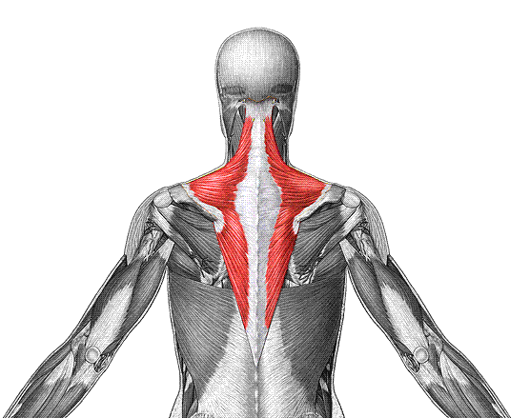
O: occipital bone, vertebrae
I: scapula
F: extend head, fix scapula
Trapezius

Slide 24
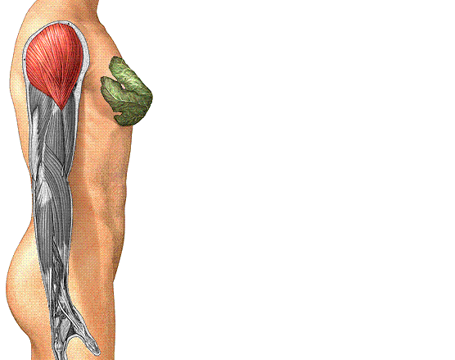
O: clavicle, scapula
I: humerus
F: abduct arm
Deltoid

Slide 25
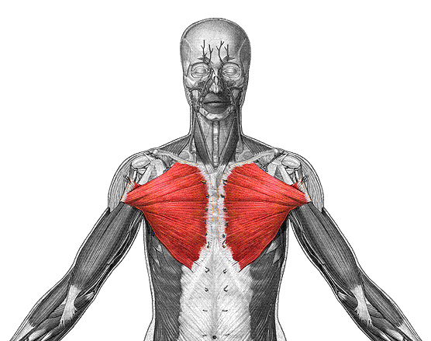
O: clavicle, sternum
I: humerus
F: flex, adduct arm
Pectoralis Major

Slide 26
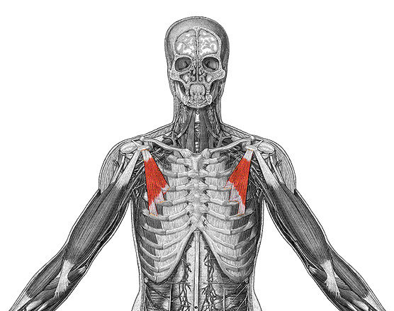
O: ribs
I: coracoid of scapula
F: depress scapula
Pectoralis Minor

Slide 27
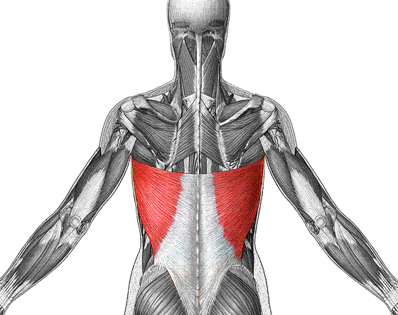
O: vertebrae
I: humerus
F: extend, adduct arm
Latissimus Dorsi

Slide 28
Muscles of the Rotator Cuff
These are known as the SITS muscles
Supraspinatus
Infraspinatus
Subscapularis
Teres minor

Slide 29
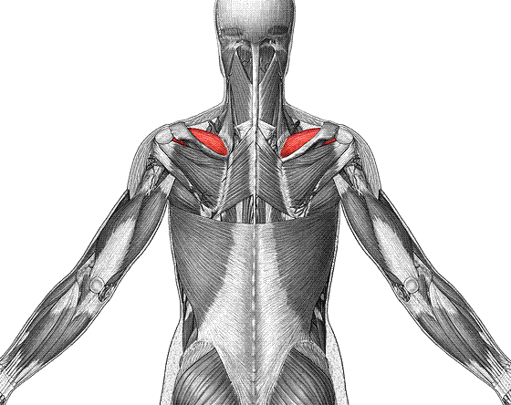
O: scapula
I: humerus
F: abducts arm, stabilize shoulder
Supraspinatus

Slide 30
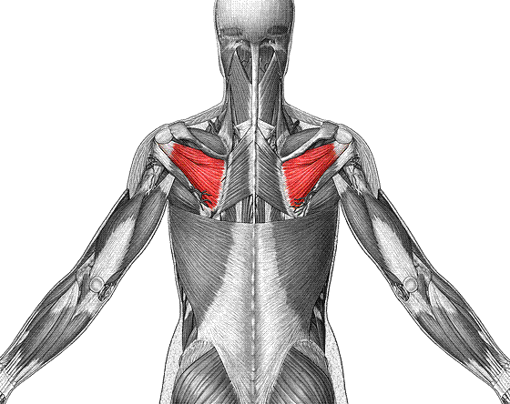
O: scapula
I: humerus
F: laterally rotate arm
Infraspinatus

Slide 31
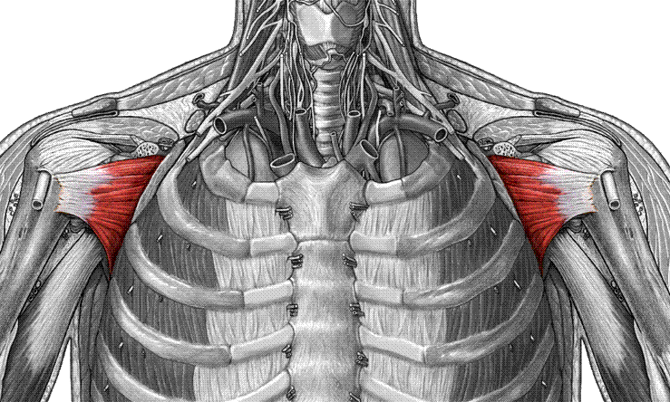
Subscapularis
O: scapula
I: humerus
F: medially rotate arm

Slide 32
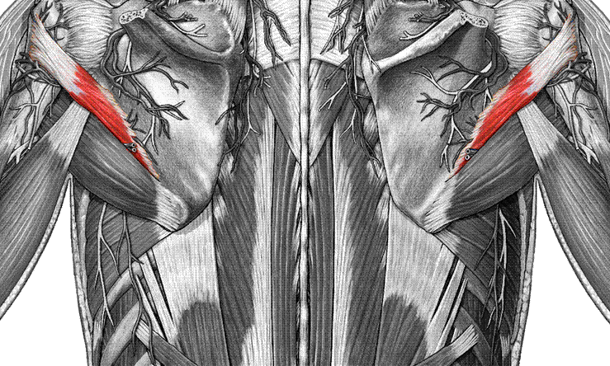
Teres minor
O: Lateral border of scapula
I: humerus
F: laterally rotate, adduct arm

Slide 33
Muscles of the Upper and lower arm
The muscle that you need to know are the
Biceps brachii
Triceps brachii
Brachialis
Brachioradialis

Slide 34
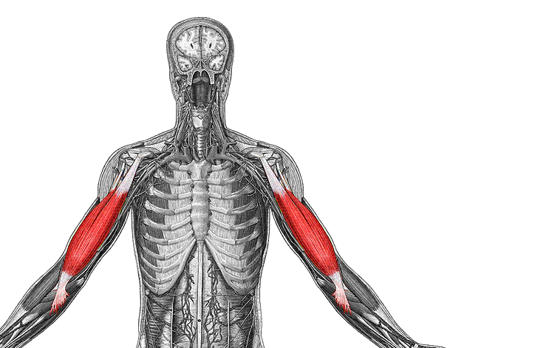
O: scapula
I: radial tuberosity
F: flex forearm & arm
Biceps brachii

Slide 35
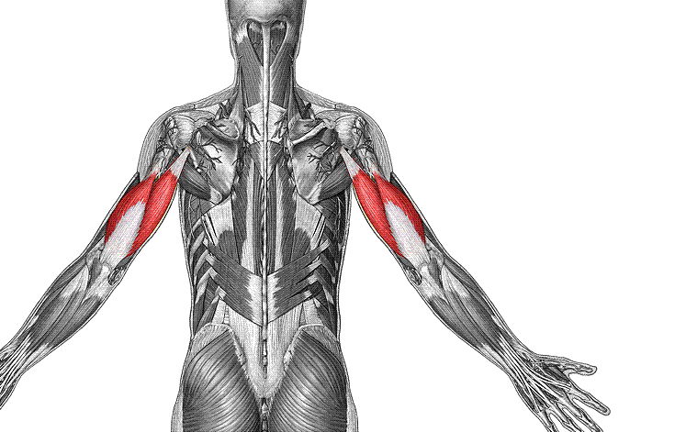
O: scapula & humerus
I: olecranon of ulna
F: extend forearm & arm
Triceps brachii

Slide 36
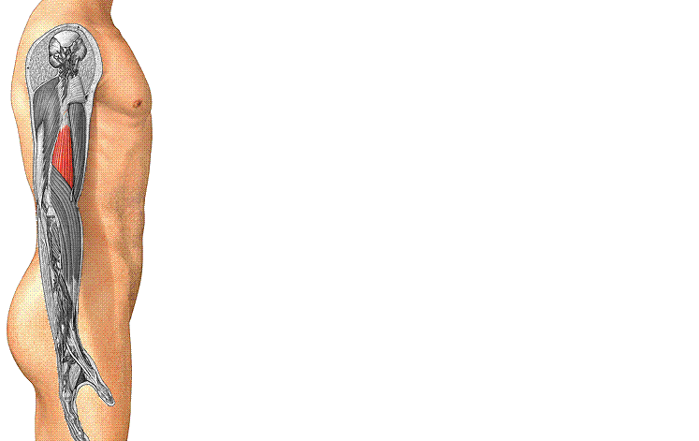
O: humerus
I: coronoid process of ulna
F: flex forearm
Brachialis

Slide 37
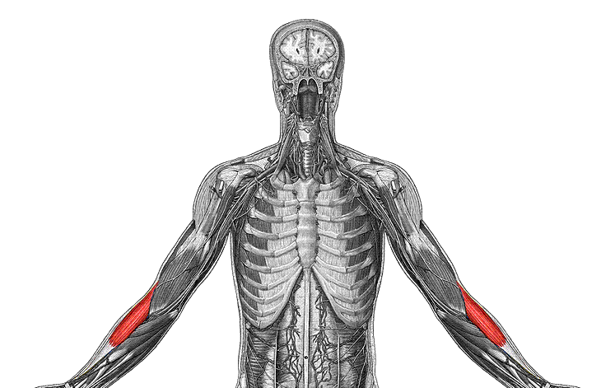
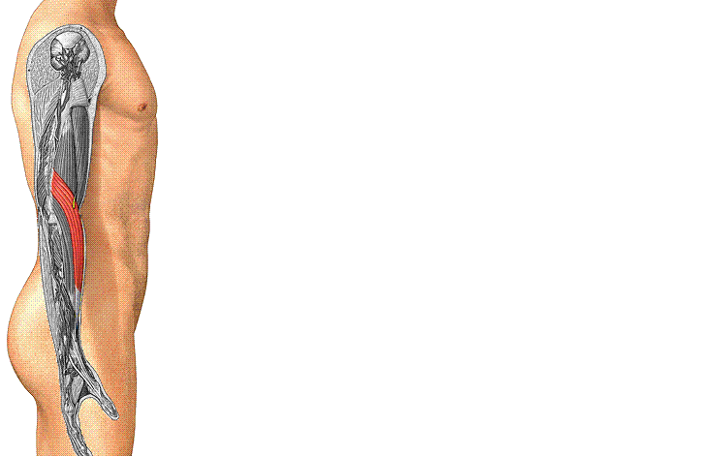
Brachioradialis
O: humerus
I: styloid of radius
F: flex forearm

Slide 38
Muscles of the Forearm
Need to know these muscles.

Slide 39
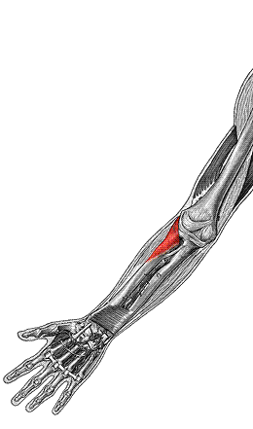
Supinator
O: humerus, ulna
I: radius
F: supinate forearm

Slide 40
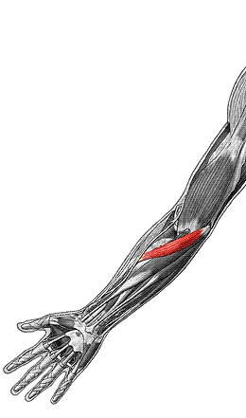
Pronator teres
O: medial epicondyle of humerus, ulna
I: radius
F: pronate forearm

Slide 41
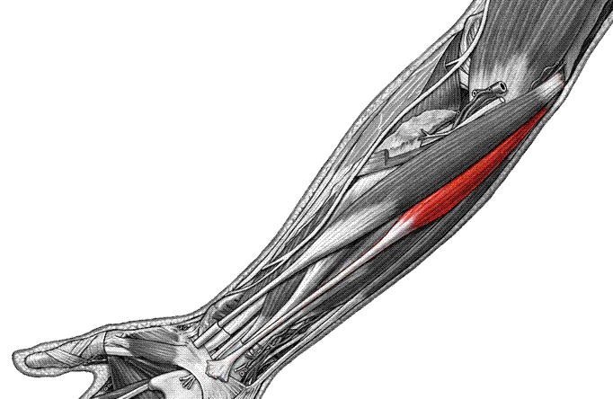
Palmaris longus
O: medial epicondyle of humerus
I: palmar aponeurosis
F: flex hand

Slide 42
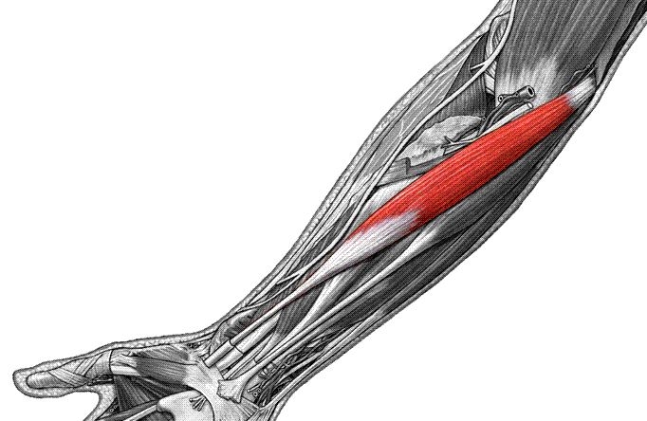
Flexor carpi radialis
O: medial epicondyle of humerus
I: 2nd, 3rd metacarpals
F: flex, abduct hand

Slide 43
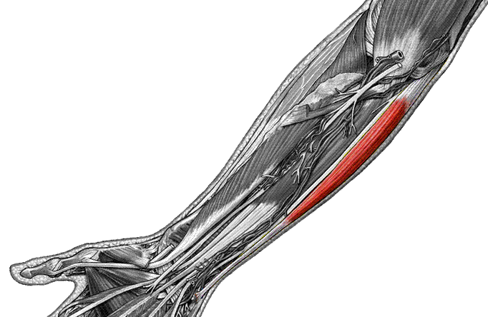
Flexor carpi ulnaris
O: medial epicondyle of humerus, ulna
I: carpals, 5th metacarpal
F: flex and adduct hand

Slide 44
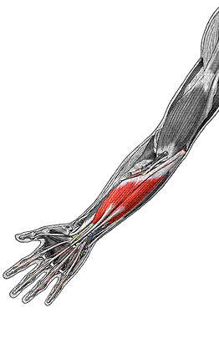
Flexor digitorum superficialis
O: humerus, ulna, radius
I: middle phalanges 2-5
F: flex hand, phalanges

Slide 45
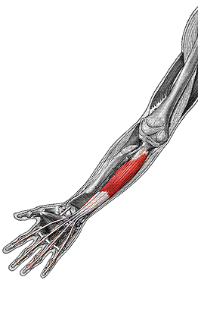
Flexor digitorum profundus
O: ulna
I: distal phalanges 2-5
F: flex hand, phalanges

Slide 46
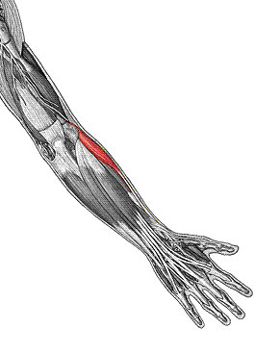
Extensor carpi radialis longus
O: humerus
I: 2nd metacarpal
F: extend and abduct hand

Slide 47
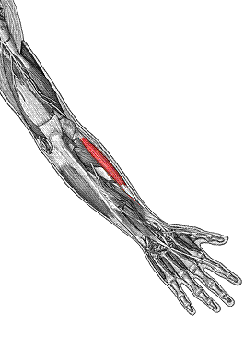
Extensor carpi radialis brevis
O: lateral epicondyle of humerus
I: 3rd metacarpal
F: extend & abduct hand

